Slide 1
Milltown Playground Renewal

Slide 2
Programme of the Day
11:30am Doors Open
12:00pm Welcome Address
12:05pm Entertainment
12:40pm Presentation by Cathal McHugh
1.00pm Entertainment
2:00pm Close
Teas / Coffees and Refreshments available throughout the day

Slide 3
History of the Playground

Slide 4
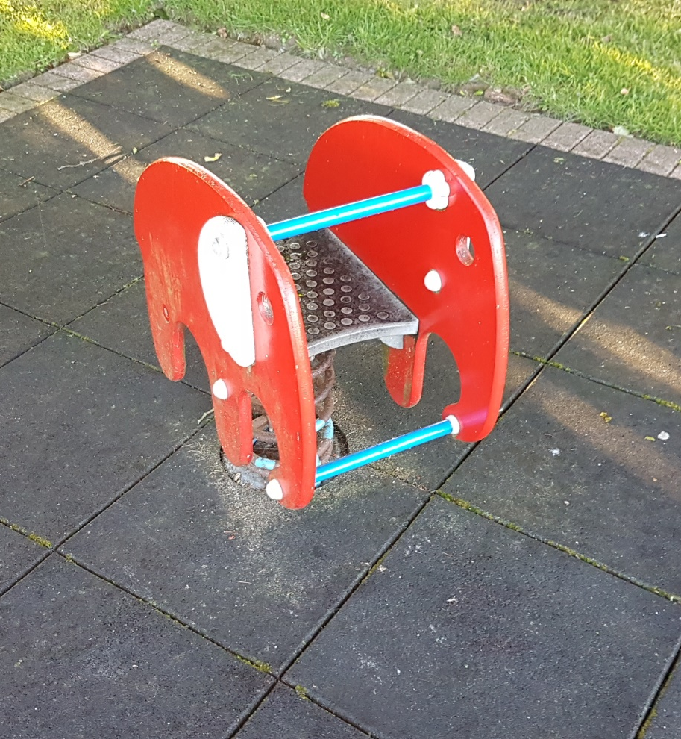
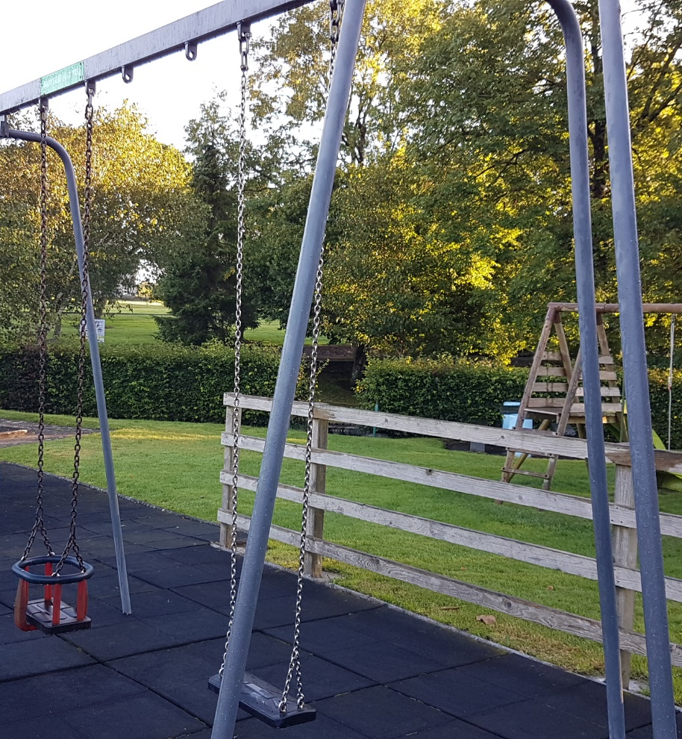
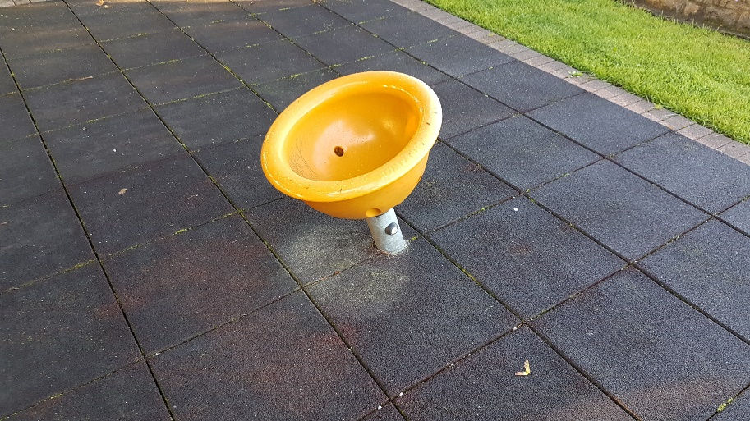
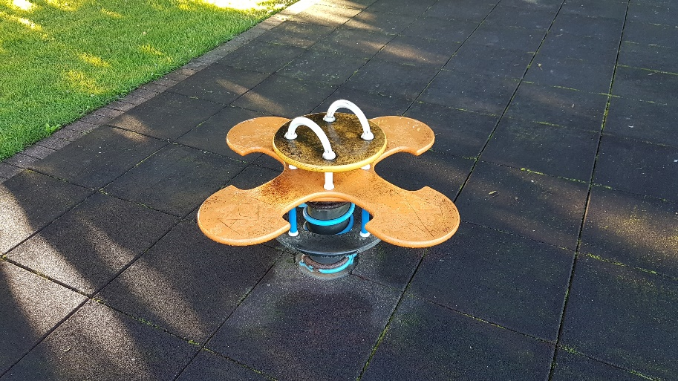
Recent Additions

Slide 5
New Playground Objectives
Child Safety
Improved play facilities
Inclusiveness
Safety Surfacing & Safety Zones
Enhanced Amenity & Social Inclusion

Slide 6
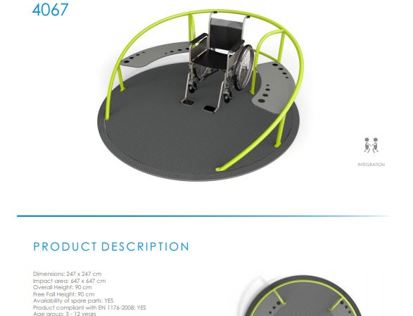
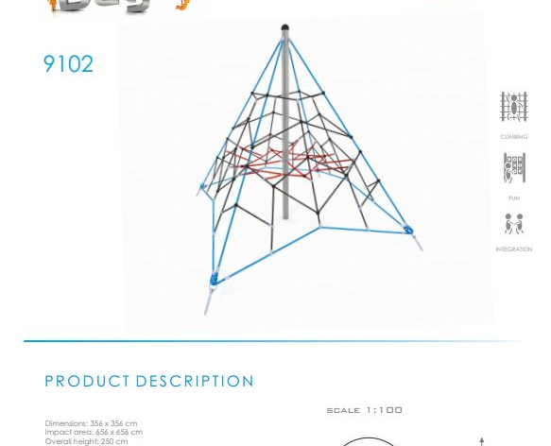
Concept Proposal

Slide 7
Funding Process Timeline
2016
Initial Proposal for Milltown Development Company
2016
Town and Village Renewal Scheme Application
2017
Leader Funding Application
2018
CLAR Funding Application
2018–2019
Fundraising Initiatives

Slide 8
What can you do?
Donate
Donate Personally
Seek
Seek donations from family & friends
Spread
Spread the word!
Share
Share the fundraising webpage link www.ifundraise.ie/milltownplayground

Slide 9
What’s next?
This Photo by Unknown Author is licensed under CC BY-SA-NC
This Photo by Unknown Author is licensed under CC BY-NC-ND
This Photo by Unknown Author is licensed under CC BY-NC-ND

Slide 10
The Big Slide!

Slide 11
Thank You! www.ifundraise.ie/milltownplayground

Slide 12
Screen Shot of Milltown Fundraising Page

